Slide 1


Project Management
EPIC
Effective
Professional
Inspiring
Competent
Fundamentals
Assessment

Slide 2
Assessment Template

Slide 3

Introduction
Name | J. Xavi Ahisha Ancy
Role | Senior Software Engineer
Experience in Years | 6 Years
Project Name | California Institute of Regenerative Medicine
Delivery Unit | Digital Engineering Services
Customer | Grant Management System
Brief Summary of Project | Providing consultation on testing and implementing a Regression Automation Test Suite involves understanding the client's specific needs and challenges, identifying issues in their current testing processes, and proposing effective solutions

Slide 4
Project & Project Management
Please insert your Project Management Plan here.
Project Management
KPI
Demonstrate to the assessment panel:
How did you select the correct project methodology
Plan has necessary details like Objective, scope, KPIs, required management plans
How you have used your learnings in the EPIC Project Management Fundamentals program to improve the project plan

Slide 5
Scope Management
Please insert your Scope Baseline & Requirements Traceability Matrix here.
Scope Baseline
RTM
Demonstrate to the assessment panel:
How you have ensured that the project scope is clearly & completely documented, agreed & signed off by customer
How you have ensured that the Requirements Traceability Matrix is correct & complete

Slide 6
Schedule Management
Please insert your Work Breakdown Structure & Schedule here.
Schedule Management
Demonstrate to the assessment panel:
Work break down is for max 1-2 days
Critical Path is known & tracked

Slide 7
Monitoring & Control
Please insert your Weekly Status Report here.
Weekly Status Report
Demonstrate to the assessment panel:
All important & relevant elements of WSR - Summary, RYG, Risks, Issues, KPIs, Changes etc
Explain how each of these is helping you provide better clarity & confidence to the customer

Slide 8
Risk Management
Please insert your Risk Register here.
Risk Management
Demonstrate to the assessment panel:
Correct risk identification & descriptions (including all 4 aspects of risk description)
Mitigation action for each risk with owners & planned dates

Slide 9
Stakeholder Management
Please insert your Stakeholder Register here.
StakeholderRegister
Demonstrate to the assessment panel:
How you have ensured that every stakeholder is identified in the stakeholder register
What is the communication plan & action plan for each stakeholder

Slide 10
Root Cause Analysis
Please insert your Root Cause Analysis document here.
Root Cause Analysis
Demonstrate to the assessment panel:
Root Cause identified for an issue on the project
Appropriate action identified with owner & plan

Slide 11
Agile Concepts
Please insert the following here:
Product Backlog
Sprint Plan
Burn Down Chart
Velocity Measurement
Demonstrate to the assessment panel how all the above artefacts & complete & correctly maintained.

Slide 12
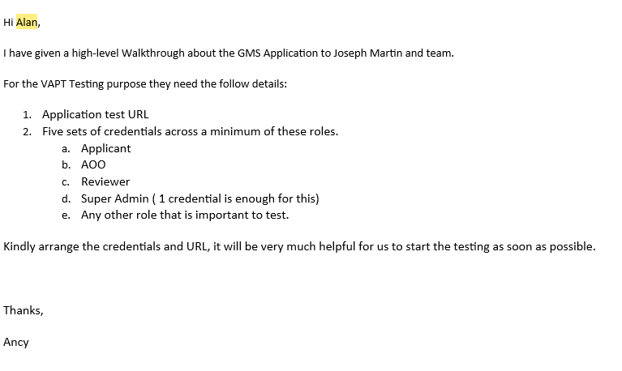
Impactful Client Communication
Please insert the snapshot of a recent email which you have sent to the customer here.
Demonstrate to the assessment panel how you have used the 5Cs framework in this email -
Clear, Complete, Considerate, Correct & Concise.

Slide 13
Learnings from the Program
Please mention the top 3 learnings from this program which have helped you become a better project manager:
1. How to create a stakeholder register and the importance of the stakeholder management.
2. How to do the project management plan and identify the critical path.
3. How we will have the client communication in the impactful way.

Slide 14
Thank You
www.ta-taualpha.org
https://www.linkedin.com/company/talent-academy-taualpha/

Slide 15
Assessment Format

Slide 16
Assessment
Knowledge Check
Online form with situational PMP-type Multiple Choice Questions (MCQs)
Competency Assessment
Through artefacts of his / her current project
To an Evaluation Panel comprising of his / her supervisor, senior manager & Trainer
Checks whether participant has understood the concepts taught in the session
Done immediately after the session
Check competency (knowledge + skill) of the participant
Done after 1 month of implementing learnings on the project
Participant will demonstrate application of learning

Slide 17
Competency Assessment
Competency Area | Artefacts | Criteria
Project & Project Management | Project Management Plan | Correct project Methodology & reasoning Has necessary details like Objective, scope, KPIs, required management plans
Scope Management | Scope Baseline | Documented, agreed & signed off by customer
 | Requirements Traceability Matrix | Documented correctly & completely
Schedule Planning | Project Schedule | Work break down is for max 1-2 days Critical Path is known & tracked
Monitoring & Control | Weekly Status Report | Has all important & relevant elements of WSR – Summary, RYG, Risks, Issues, KPIs, Changes etc

Slide 18
Competency Assessment
Competency Area | Artefacts | Criteria
Risk Management | Risk Register | Correct risk descriptions Mitigation action with owners
Stakeholder Management | Stakeholder Register | Complete & correct list Communication plan & Actions
Quality Management | Root Cause Analysis (RCA) document | Root Cause identified Appropriate action taken
Agile Concepts | Product Backlog Sprint Plan Burn Down Chart Velocity Measurement | Complete & sufficient
Impactful Client Communication | Recent Email samples | 5 C framework – Clear, Complete, Considerate, Correct & Concise

